Slide 1
Induvial Case Study – Credit Card Marketing
IE 509: Six Sigma Quality
Presented by
Gabriel Colangelo

Slide 2
Introduction
An experiment was designed using 2^k factorial design to see if the number of credit card orders was affected by changing the certain factors
The following 4 factors were involved: annual fee, account operating fee, initial interest rate, and long-term interest rate
The levels for each factor were as follows: (-/+) = (control/new idea)
Keep (-) or lower annual fee(+)
Keep (-) or lower initial interest rate (+)
Higher (+) or low (-) long term interest rate
No account operating fee (-) or include account operating fee (+)

Slide 3
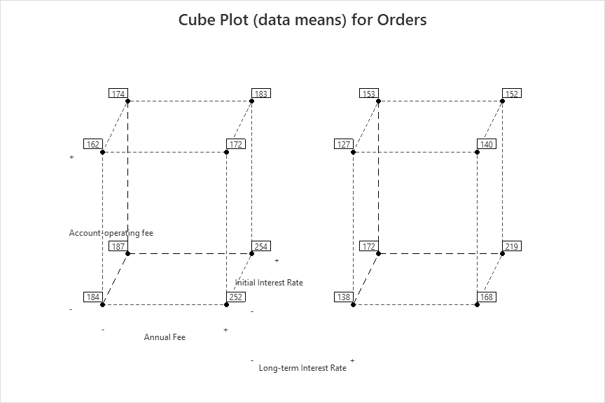
Cube Plot
The following cube chart was generated for this designed experiment and its collected data

